Slide 1
How Can You Protect Your Family for Generations to Come
Presented By:
John Doe Agent
888-888-8888

Slide 2
We Would Like to Welcome You to Todays Workshop
Our Hope Today is to Provide You with some valuable information for you and to share with your family; Our goal is to answer any questions in the next ½ hour.

Slide 3
Our Goal Today is to Teach You How to Protect Your Family.
We offer the first Advance Funeral Planning Product that is payroll deducted and is Paid Directly to the Funeral Home for Your Families Needs.
It is very difficult to Make These Decisions on What might be considered the Worst Day of your Lives.
“Thank you for having the courage to have this discussion today. It is a difficult topic for some, and we realize that some of you may have experienced a recent loss.”

Slide 4
What Is The Average Cost Of A Funeral Service?
The average funeral cost in America is $7,360 for a funeral and burial and $6,260 on average for a full cremation service, according to National Funeral Directors Association, but funeral prices can vary a great deal depending on the specific services needed.
A burial plot in a private cemetery: The average cost of a single burial plot is $2,000 to $5,000, depending on where the cemetery is located, the cemetery's amenities, and whether the plot is in a more desirable section within the cemetery.

Slide 5
“Don’t Worry, Mom. We’ll Take Care of Everything.” Children Don’t want to make these Decisions for Their Parents
Your children will surely have the best intentions and believe they can provide for your future needs. Because we don 't know what our personal circumstances will be when a loved one dies, planning ahead prevents this problem. Your child may have a difficult financial or personal circumstance that could prevent him or her from fulfilling the very sincere promise " to take care of everything."

Slide 6
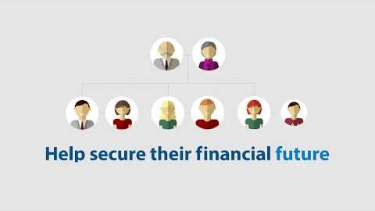
How to save your family from the financial burden by protecting their finances with preneed funeral home insurance.

Slide 7
Making a choice based upon preference is important to many people. Creating a prearranged funeral plan provides us with just that opportunity. Planning your own funeral and final resting place, ensures that your wishes will be known to your loved ones, providing them with a valuable guide to follow.
A Funeral Is a Matter Of Personal Choice, Do you know what your Parents and Family Wants?

Slide 8
Our Plans are structured to allow benefits for the entire family:
Yourself/ Spouse Siblings
Parents/In Laws Children/Grandchildren
Aunts/Uncles Cousins
Grandparents Grandparents In Law
There is NO Medical Exam Required-Regardless of Health- Everyone Qualifies
Payment for Coverage can be through Payroll Deduction or Direct Payment from the Family Member.

Slide 9
'
When death comes unexpectedly, too many times the deceased had never communicated to a spouse or loved one his or her personal wishes regarding final arrangements. When this occurs, the spouse or loved one is under extreme pressure to make quick decisions, usually with the need to satisfy the unknown questions:
This can be very difficult , even unfair, knowing such communication could have taken place prior to death.
What Would Mom or Dad have Wanted?

Slide 10
Please fill out Our Evaluation Form and Communicate with Your Agent/Presenter to Sign Up Today

Slide 11
Thank You for Joining Our Presentation Today
Agent Name
888-888-8888
www.agentswebsite.com

