Slide 1



The Benefits of Preneed
Funeral Planning
Your Funeral Home Logo Here
Presenter’s Name

Slide 2
Thank You for Joining Us Today
  The workshop is to share ideas and information for you to learn about some important topics that affect us all.
  Please fill it out the Evaluation Form and I will pick it up at the end of the workshop. We will make sure you get a copy of our Planning Guide
03/26/2026

Slide 3

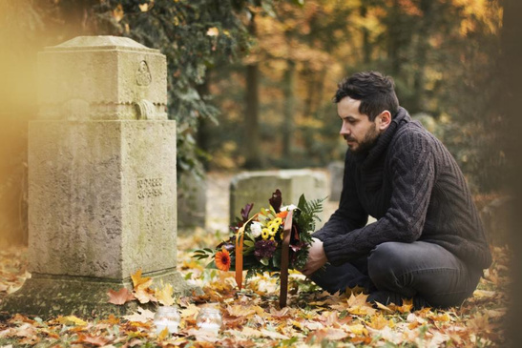
“When a person is born, we rejoice
and when they’re married, we jubilate but when they die, we try to pretend that nothing has happened.”
- Margaret Mead
Funeral Home Name
American Cultural Anthropologist

Slide 4

Question
If there had been a death in your family yesterday, what would you be doing today? If “You” had died yesterday, who would be
making your funeral arrangements today?
Are you Prepared?
Funeral Home Name

Slide 5

Preparing When
Someone Dies. Did you know?
Someone must....
  Choose a funeral provider
  Arrange for funeral service
  Decide how much money to spend, and pay for the services before the funeral
  Select a casket
  Select clothing and jewelry to be worn
  Select cemetery property
  Prepare the death certificate
  Arrange for various permit
  Contact the clergy
  Choose pallbearers
  Provide complete family history
  Contact Social Security
  File for insurance benefits
  File all other necessary documents
  Notify the newspapers
  Notify union, fraternal, and other organization
  Design and purchase a cemetery memorial
Funeral Home Name

Slide 6

Planning Ahead
Planning ahead for funeral arrangements is an uncommon tradition. In the past, a family would usually provide for the final emergency in one of three ways:
  Personal Life
  Insurance Savings
  Friends and Relatives
We Have a Better Idea
Funeral Home Name

Slide 7
Personal Life Insurance
Typically, life insurance was purchased to provide for the survivors and for their continued support
  Using these funds for the funeral arrangements was never the real purpose for the policy
  Some policies are part of our employment and may terminate at retirement or may not have lasting benefits
  Some policies must be cashed in to qualify for long-term care by the state
  It often takes several weeks to receive policy benefits for traditional life insurance, leaving the family responsible for the funeral bill immediately
Funeral Home Name

Slide 8
Personal Savings
Even if we have substantial savings
  Experience shows us that often a death follows a lengthy, expensive illness or a tragic accident
  Costs for long-term care (nursing home) are escalating at an astronomical rate
  Our savings must be depleted BEFORE we can qualify for Medicaid
75% of a person’s wealth can be exhausted in the last 90 days of a person’s life.
Funeral Home Name

Slide 9
Friends and Relatives
Many people rely on Friends and Family to Accept the Financial and Emotional Responsibility of Providing for Their Final Arrangements
This can be the Last Resort and not a Desirable Situation that You would Preferred.
How and Who is Going to Help You?
Funeral Home Name

Slide 10
What Is The Average Cost Of A Funeral Service?
The average funeral cost in America is $11,000 for a funeral and burial and $3,700 on average for a full cremation service, according to National Funeral Directors Association, but funeral prices can vary a great deal depending on the specific services needed.
Funeral Home Name

Slide 11
Funeral Pre-Planning
Today, more and more people recognize the financial and emotional advantages of planning their funeral in advance.
  Gain a proper peace of mind because you have arranged your funeral.
  Personalize your funeral, deciding what you do and don’t want.
  Secure today’s funeral rates and save money.
  Eliminate the worry of loved ones paying for the funeral.
  Lessen the stress, emotional and financial portion death takes on the family.
Which of These are Important to you?

Slide 12
We Are The ONLY Program That Makes A Benefit Available For The WHOLE Family On ONE Platform.
Who you Can Offer the Coverage to:
  Spouse
  Parents/In Laws
  Children
  Grand Parents/Grand Parents in Law
  Siblings on Both Sides
Funeral Home Name

Slide 13
Funeral Pre-Planning
Step 1: Record Personal and Family Information
  Using our Program, we record your personal history
  Include your Memorial Instructions
  Provides you with important information about Social Security, Veterans Benefits, Probate, Wills, and Living Trusts.
Funeral Home Name

Slide 14
Funeral Pre-Planning
Step 2: Funeral Service Arrangements
  Complete a “pre-planned” funeral arrangement contract
  Choose type ofServices and Merchandise
  Plus you can designate funds for services you want:
Chapel Service, Obituary Notice, Flowers, etc.
Pay for your plan in advance and
“guarantee” the costs
Funeral Home Name

Slide 15
Summary For Today
The Wrong Way
The Right Way
Indecision
Haste
Worry
Grief
Uncertainty
Stress
Comfort
Economical
Good Memories
Security
Decisions Made Together
Plan for Tomorrow and Your Security
Don’t Leave the Decision for Your Kids
Funeral Home Name

Slide 16
Thank You!
Please make sure to fill out your Evaluation. We are happy to answer any questions you might have.
We are here for you on this journey.
03/26/2026

